Slide 1


Slide 2

Deep Dive in to Storage Spaces Direct and what’s coming in build 1803
Jan-Tore Pedersen
Senior Consultant @Skill AS
Twitter: @jantorep
Blog: jtpedersen.com

Slide 3

Agenda
What is Storage Spaces Direct (S2D)
Deploying Storage Spaces Direct
Performance
Patching and servicing your S2D deployment
Monitoring S2D
Troubleshooting S2D
My DIY S2D Home Lab
Windows Server 2016 1803 for S2D
Get Involved

Slide 4
What is Storage Spaces Direct??

Slide 5

Storage Spaces Direct is software-defined,
shared-nothing storage.

Slide 6
Use industry-standard hardware to build
lower-cost alternative to traditional storage.

Slide 7





Slide 8
Industry-standard servers with internal drives

Slide 9
No shared storage, no fancy cables – just Ethernet

Slide 10
Create cluster

Slide 12
STORAGE POOL
Software-defined “pool” of storage

Slide 13
STORAGE POOL

Slide 14
VOLUMES
STORAGE POOL
Create volumes

Slide 15
What does that mean for redundancy

Slide 16


VM
VM
VM
VM
VM
VM
VM
VM
SERVER
SERVER
SERVER
VOLUMES
SERVER
DRIVES

Slide 17
SERVER
SERVER
SERVER
VOLUMES
SERVER
×
DRIVES

Slide 18
SERVER
SERVER
SERVER
VOLUMES
SERVER
×
DRIVES

Slide 19
SERVER
SERVER
SERVER
VOLUMES
SERVER
×
×
DRIVES
×
×
×
×
×

Slide 20
SERVER
SERVER
SERVER
VOLUMES
×
SERVER
×
DRIVES
×
×
×
×
×

Slide 21
SERVER
SERVER
SERVER
VOLUMES
×
SERVER
×
DRIVES
×
×
×
×
×
All data stays online and accessible

Slide 22
VM
VM
VM
VM
VM
VM
SMB3
File Shares
VOLUMES
STORAGE POOL
Scale-Out File Server (SoFS)

Slide 23
VM
VM
VM
VM
VM
VM
VOLUMES
STORAGE POOL
Hyper-Converged Infrastructure (HCI)

Slide 24

Simple scalability and expansion
From 2 – 16 servers, and up to over 400 drives
Up to 1 PB of raw storage per cluster
Add servers to scale out
Add drives to scale up
Cluster automatically balances virtual machines
Pool automatically absorbs new drives and rebalances storage
Ethernet fabric greatly simplifies expansion

Slide 25

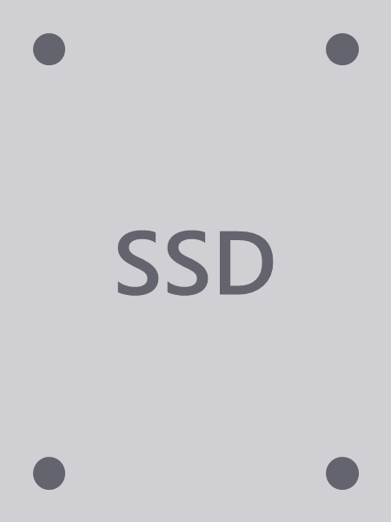


Types of drives
Non-Volatile Memory Express
Connected via PCIe. Includes M.2, U.2, Add-In-Card, and Intel Optane (3D X-Point).
Solid-State Drive
Any Enterprise SSD connected via SATA or SAS. Must have power-loss protection (PLP).
Hard Disk Drive
Any HDD connected via SATA or SAS. 7.2k RPM or higher recomended.
* Drives must be exposed as-is, either directly to motherboard or via HBA in pass-through mode; no RAID.

Slide 26
Deploying Storage Spaces Direct

Slide 27
Choosing the Right Hardware
Choose a certified vendor that is on Microsoft SDDC list for S2D
For RoCE/iWarp use certified NIC’s for SDDC
Use Certified SES backplanes
Choose the correct setup for your application
All Flash
NVME + HDD
SSD + HDD
NVME + SSD + HDD
4 Nodes or 10 Nodes or maybe 16 Nodes?
Min 10Gbit networking, RDMA recomended
Choose a certified SDDC switch for RDMA
Recommended 25Gbit for all flash 4 node, and 40Gbit above 4 node
Use supported firmware and drivers from vendors
https://docs.microsoft.com/en-us/windows-hardware/test/hlk/testref/partner-guide-to-wssd-certification

Slide 28








Vendor offers available for your datacenter
New vendors joining the program all the time

Slide 29

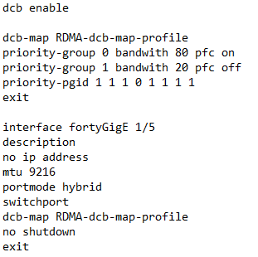
Switches
Technically RoCE requires a switch that supports DCB, PFC and ETS. Normal etherpause is not enough
Switch need to support mLAG or vLAG
Dell S or Z series switches, easy to configure
Mellanox
Cisco Nexus 5000 series and above
Lenovo Rack Switches
HPE FlexFabric 5700 and 5900

Slide 30
Switches
iWarp
Does not require PFC but it’s recommended, but do require DCB
Can use any switch without PFC
For PFC I would use same switches as RoCE

Slide 31
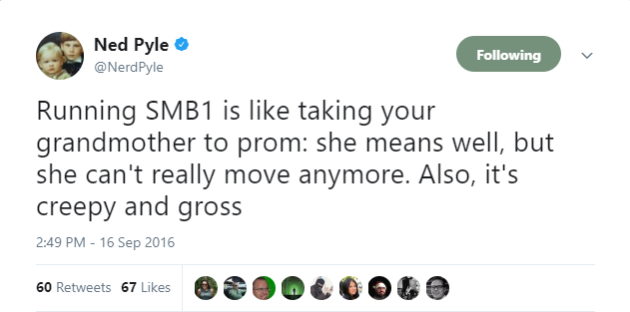
Installing S2D
What do I need on the servers
Fully Patched
All firmware and drivers Up to date, check your vendors approved list
Domain Joined
Firewalls rules open or off
Windows Features
Failover Clustering
Hyper-V
File-Services
Data Center Bridging

Slide 32
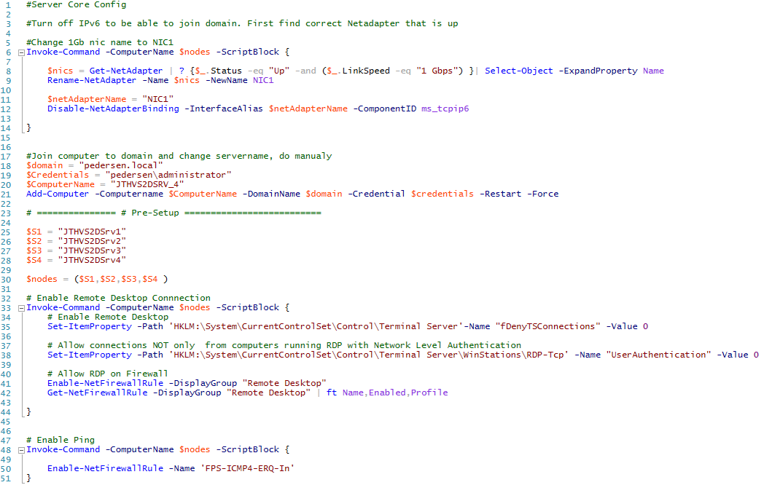
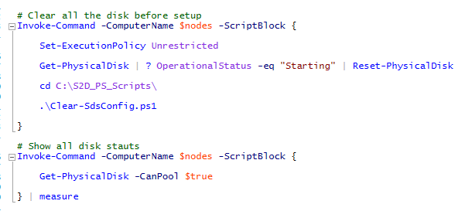
Can i have script?

Slide 33
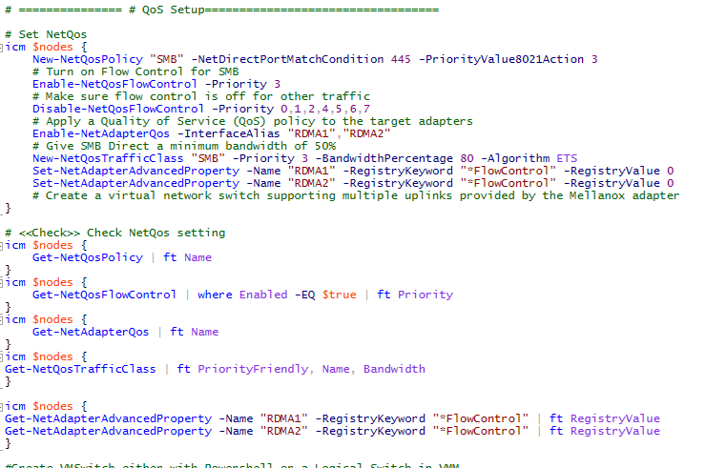
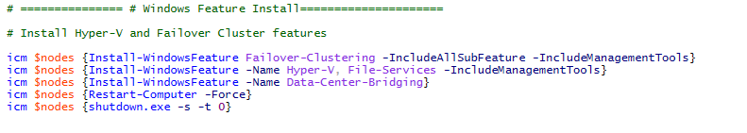
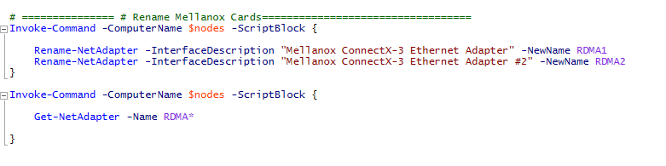

Slide 34
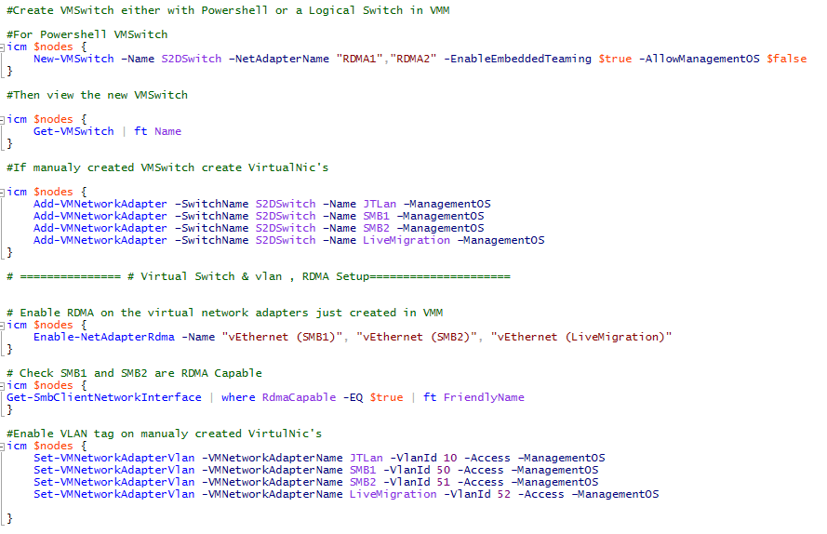
Virtual Switch Setup
Powershell
VMM
Notes:
DEMO

Slide 35
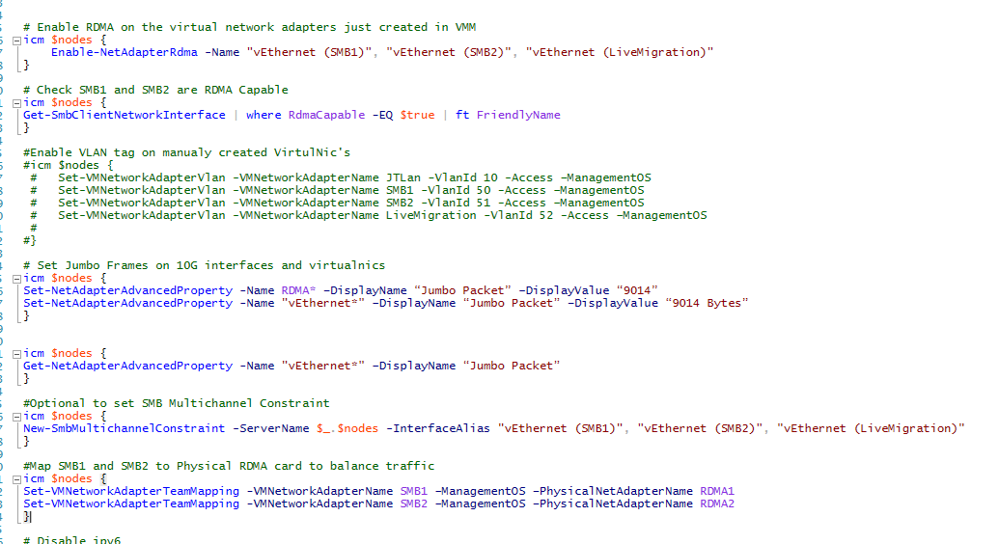

Slide 36
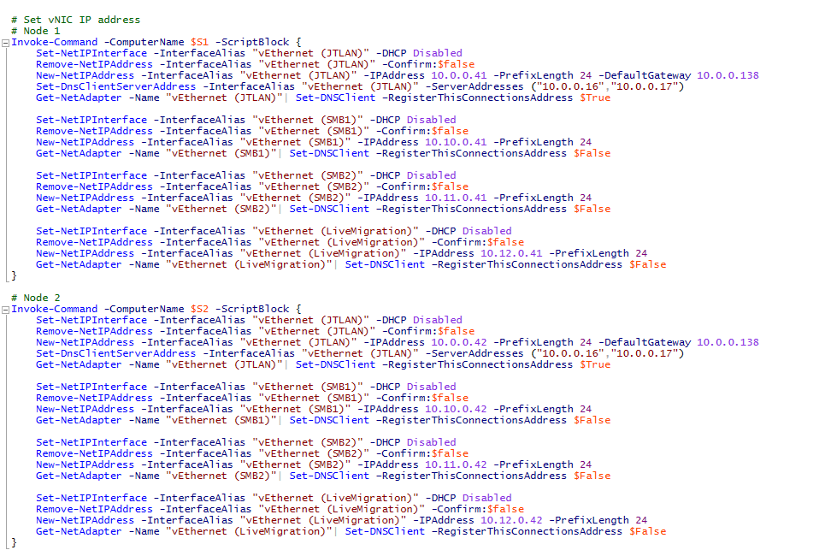
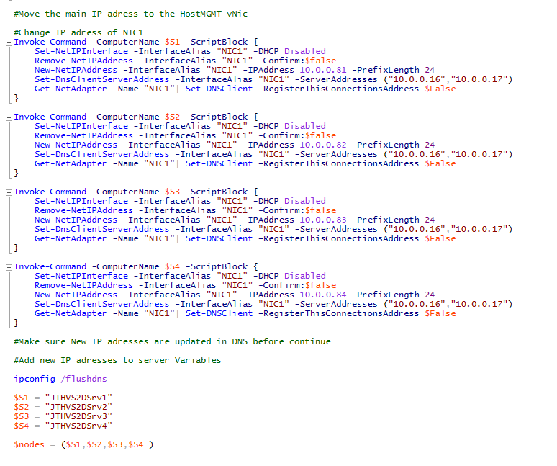
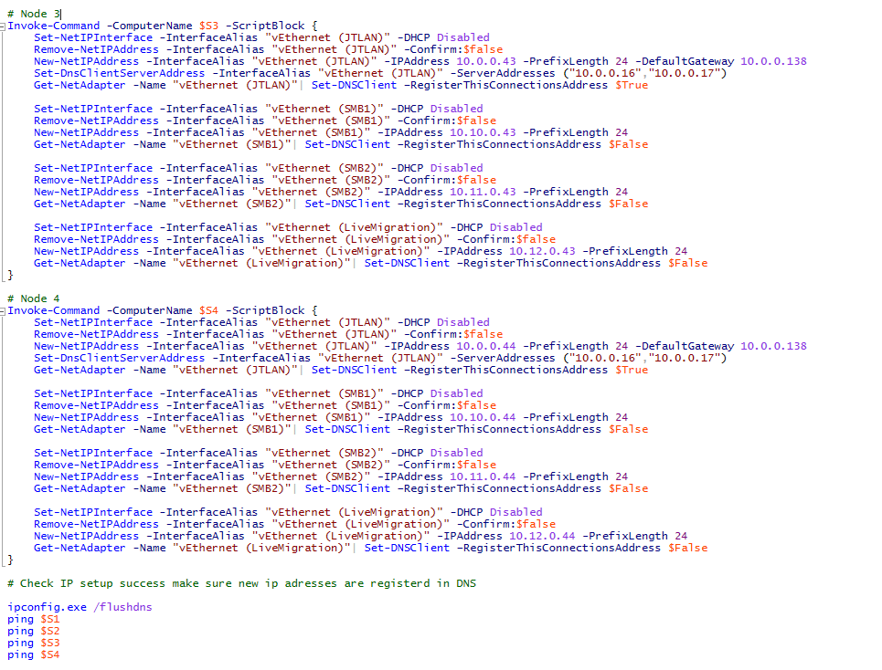

Slide 37
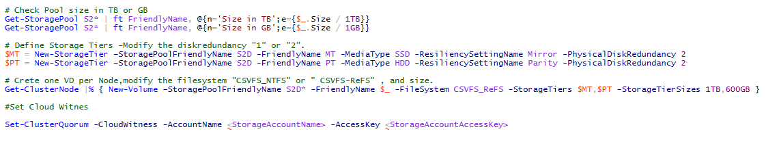
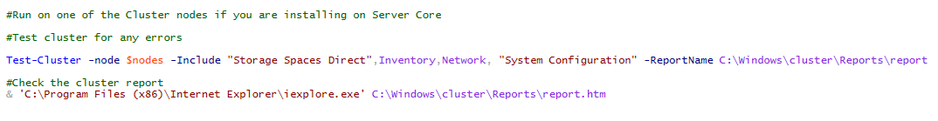
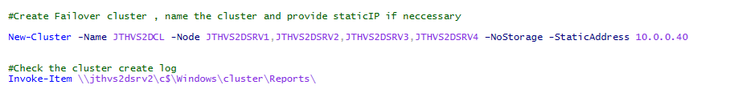
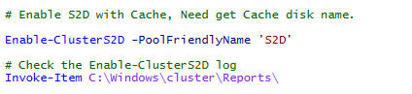
Let’s create the cluster
Notes:
DEMO

Slide 38
Performance with S2D

Slide 39
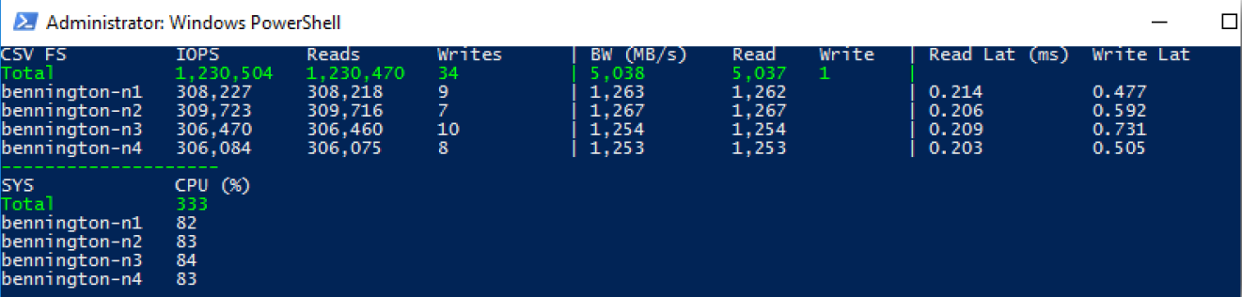
4 Node Dataon S2D-5212i NVME + SSD +HDD + RoCE

Slide 40
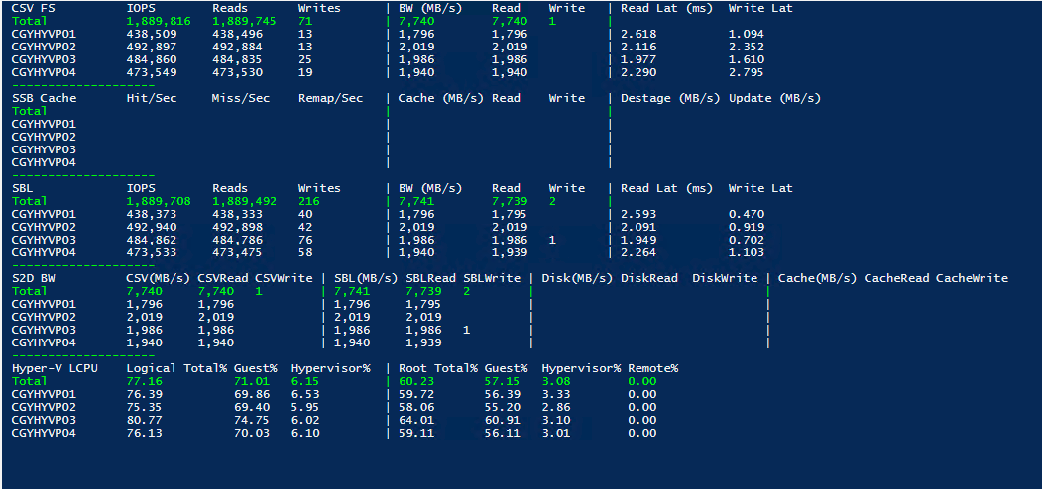
4 Node Dell EMC Ready node All Flash SSD + RoCE

Slide 41
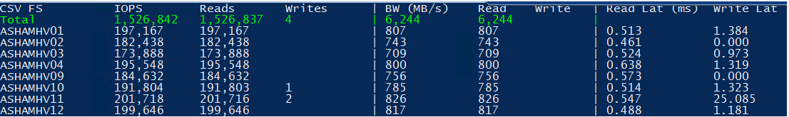
8 Node R730XD Intel S3710 800GB Cache and 4TB Sata HDD + RoCE

Slide 42
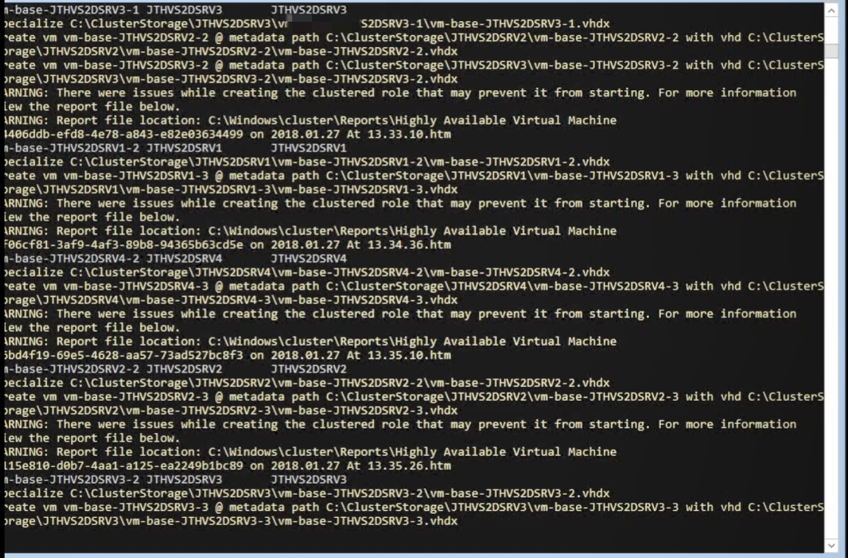
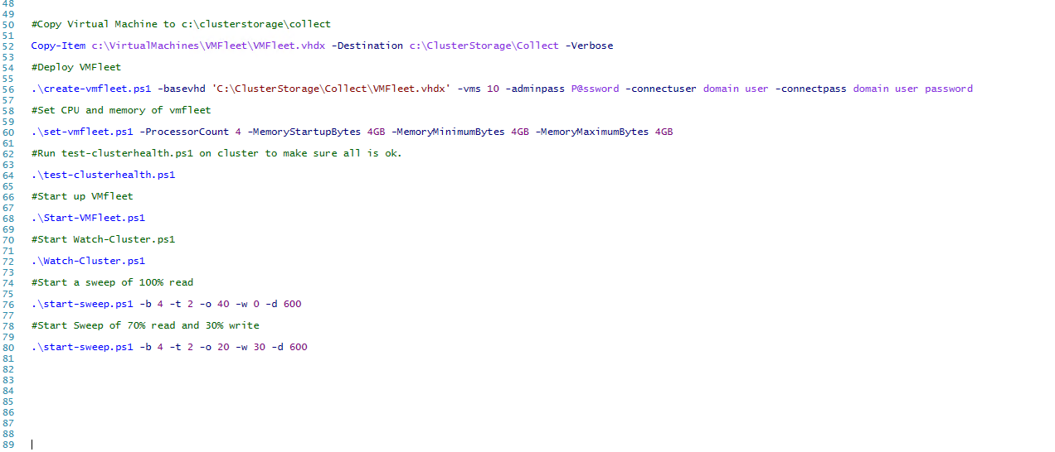
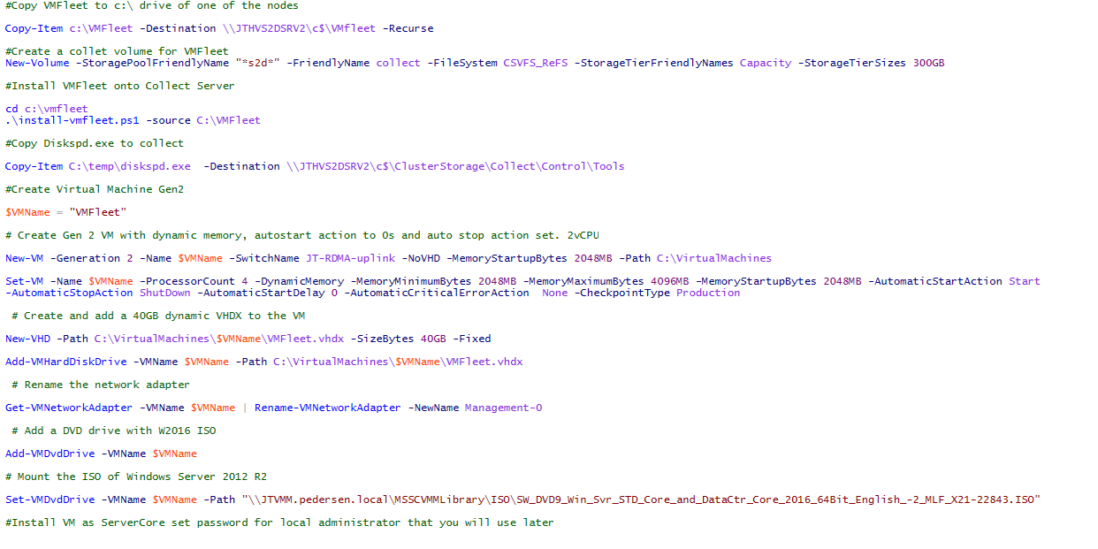
VMFleet
https://github.com/Microsoft/diskspd/tree/master/Frameworks/VMFleet
https://www.jofe.ch/how-to-setup-vmfleet-to-stress-test-your-storage-spaces-direct-deployment/
Notes:
DEMO

Slide 43
Patching and Servicing your S2D Deployment

Slide 44
Patching S2D
Update Manually
Cluster Aware Updating
System Center Config Manager
Impact of installing Meltdown and Spectre patches

Slide 45
Manual Process
Pros
Full Control
Patch 1 wait 1 day
Make sure VM’s and disk’s are back on correct node’s
Cons
You will need to patch your self
Takes a while to do as you need to wait for Storagejob’s

Slide 46
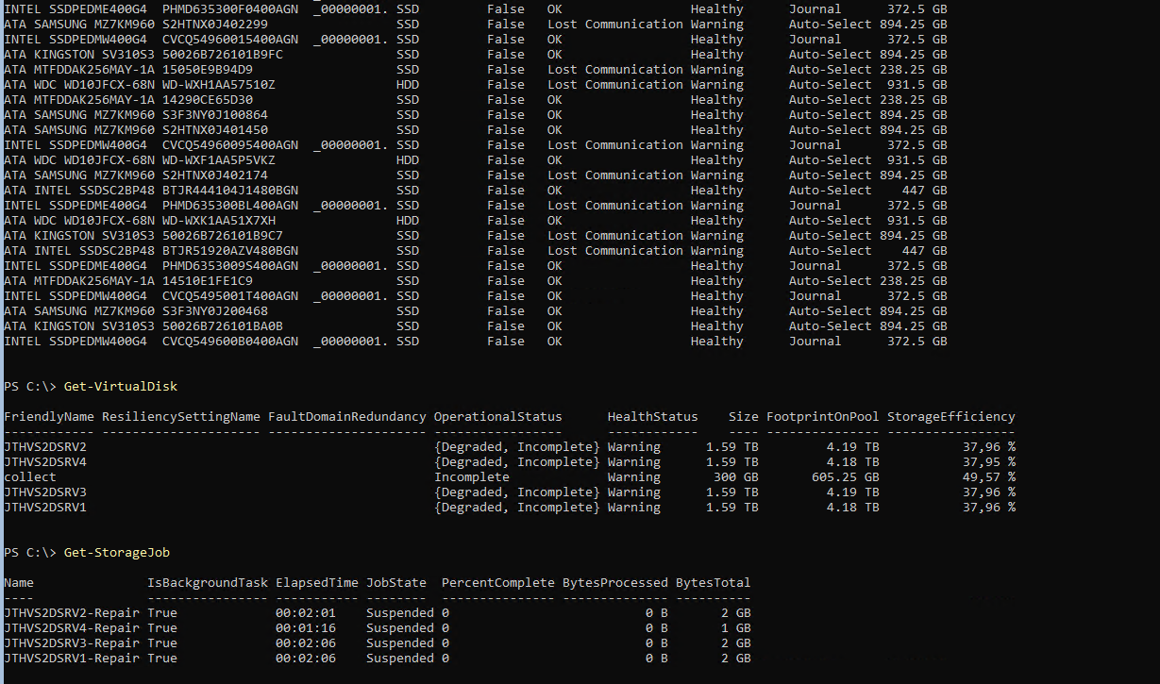
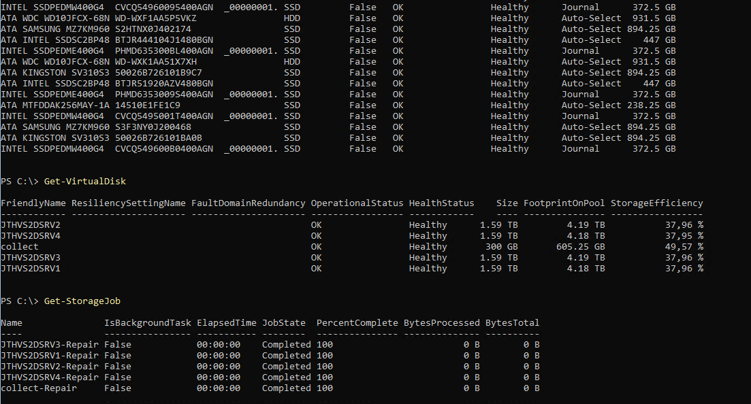
What to look for when patching S2D
Check Physical Disk’s that they are ok after reboot. Get-Physicaldisk
Check for storagejob’s to finnish. Get-Storagejob
Check that virtualdisk’s are ok before you do next node Get-Virtualdisk

Slide 47
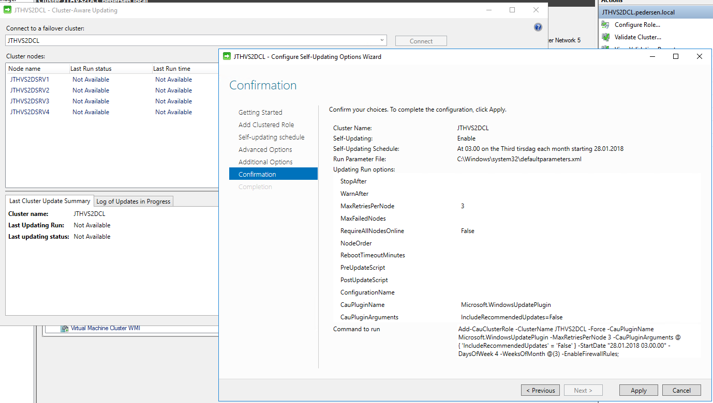
Cluster Aware Updating
Pros
Automatic Updating
Fast for user, don’t need to watch
Stops if cluster get degraded, and does not continue
Cons
If failures happen and cluster get degraded you will need to check
Does not have report service to send mail
Does not balance disks back to correct nodes

Slide 48
System Center Config Manager
Pros
Automatic Updating
Fast for user, don’t need to watch
Stops if cluster get degraded, and does not continue
Cons
Pretty complex to setup with orchestrator runbooks
Takes a while to get correct patch setup
Can mess things up if not correct setup

Slide 49
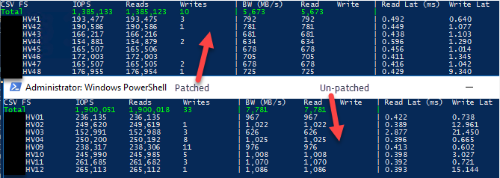
Meltdown/Spectre Intel Bug
Decide if you need or not need to install mitigations
A good guide from MVP Charbel Nemnom https://tinyurl.com/y7toohwz
Don’t install processor microcode
Link to uninstall Microcode from Microsoft https://tinyurl.com/y7swwzbn

Slide 50
Monitoring S2D What options do i have?

Slide 51
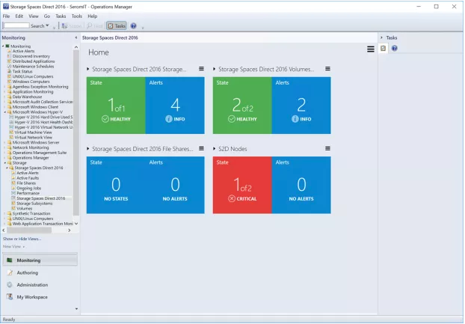
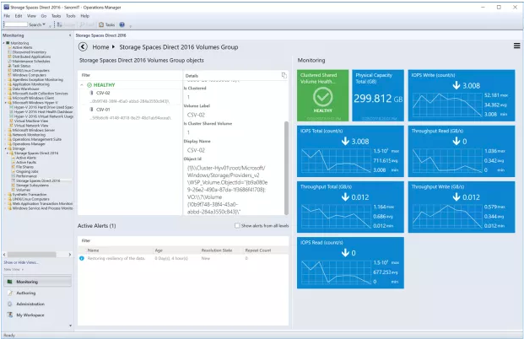
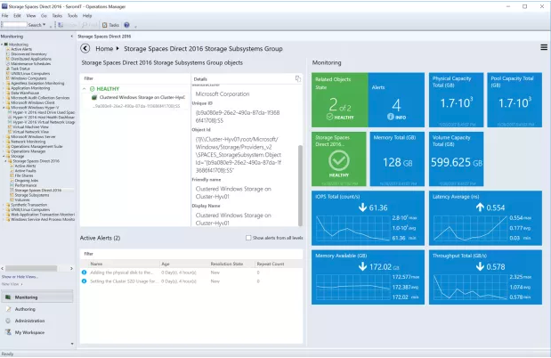
System Center Operations Manager

Slide 52
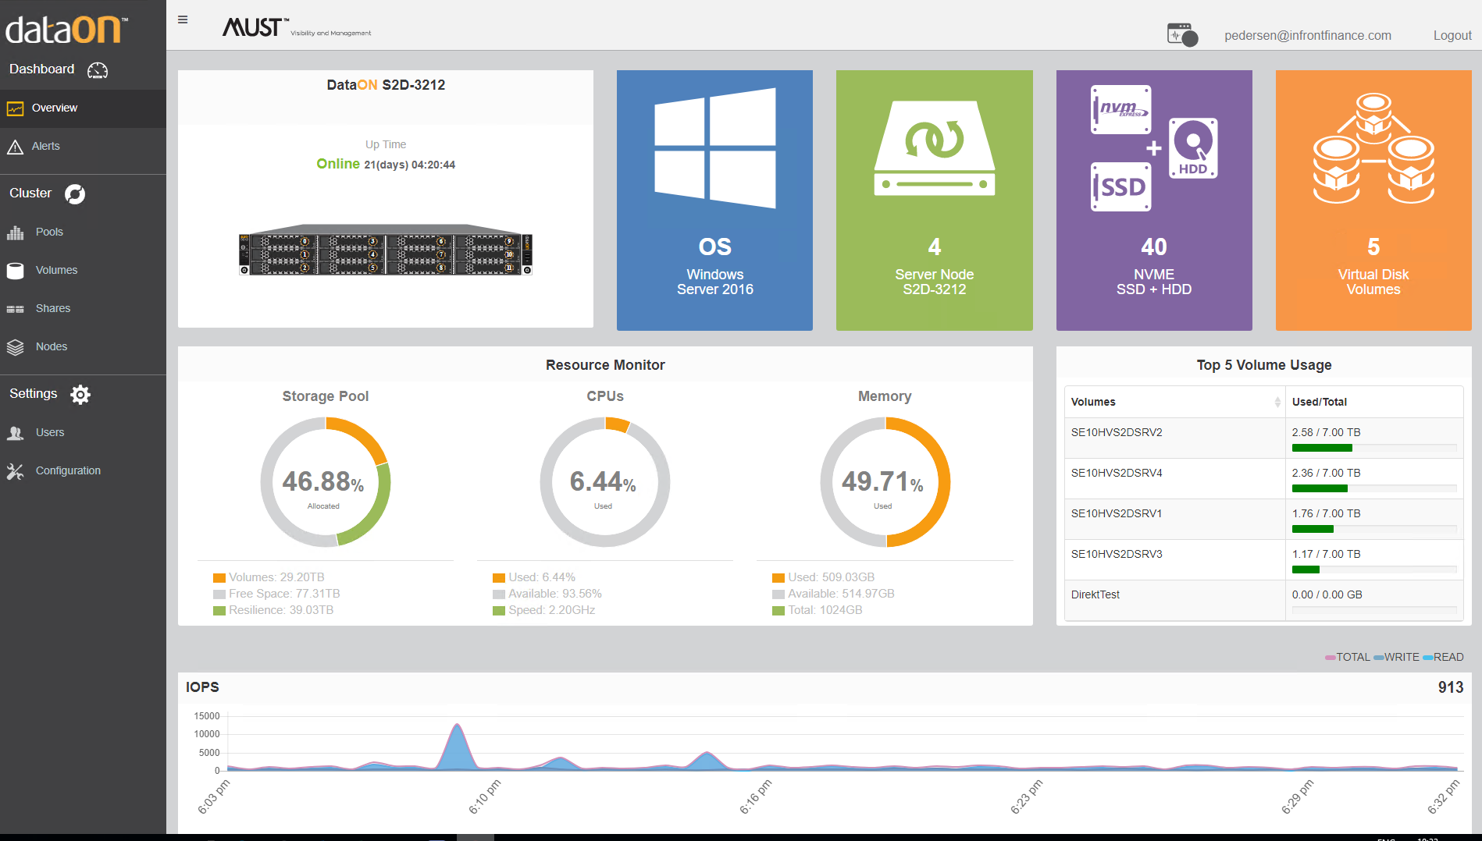
Dataon Must (Only available on Dataon HW)

Slide 53
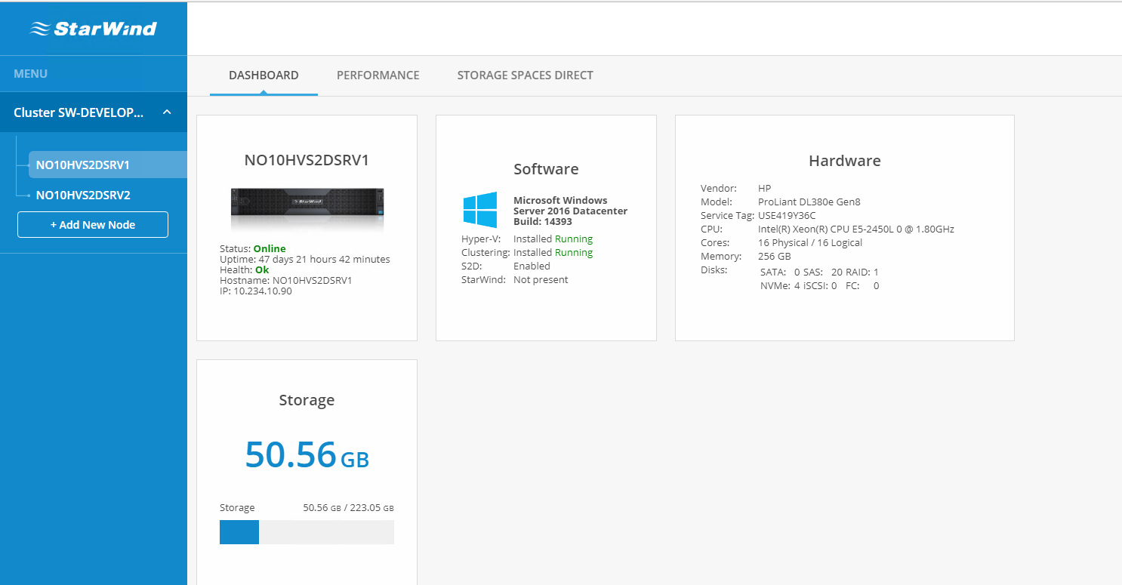
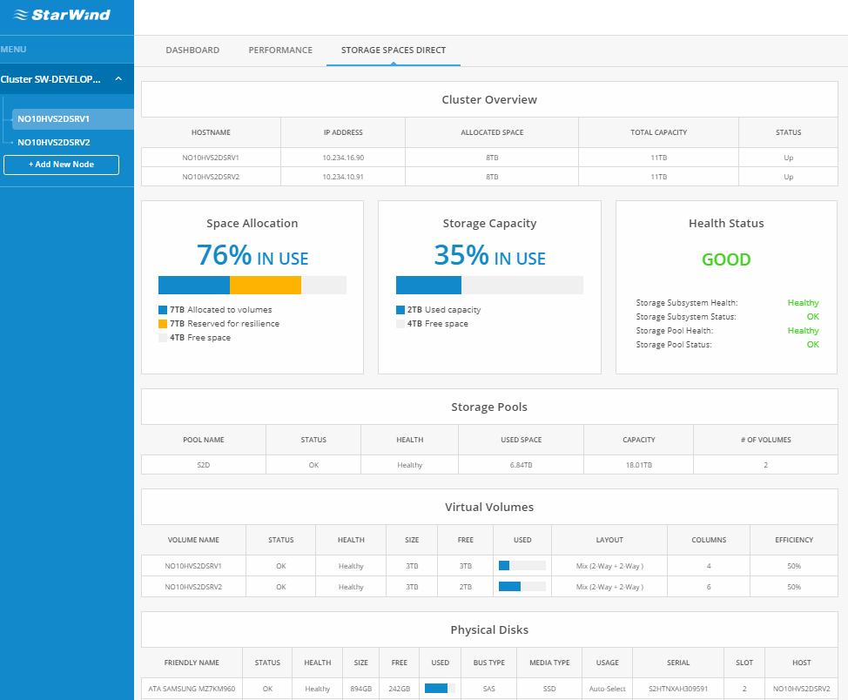
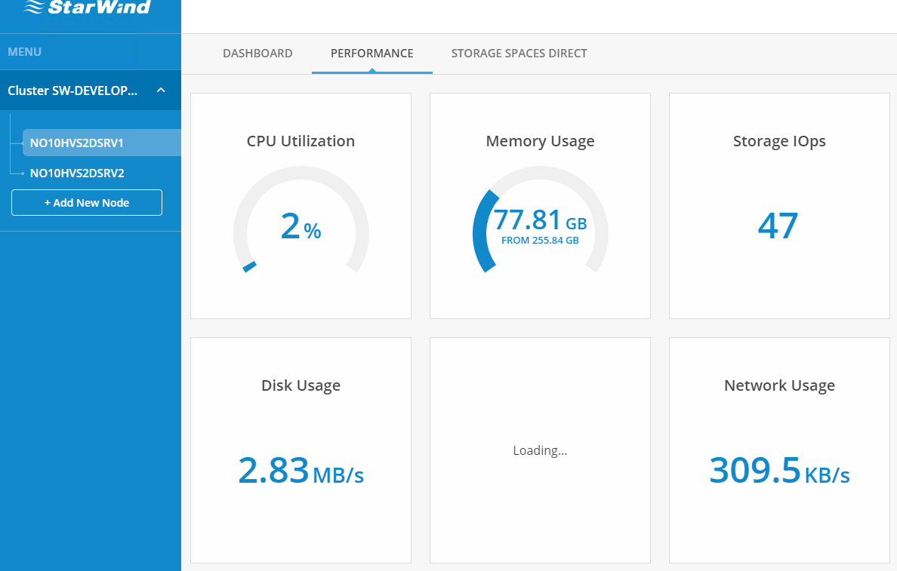
StarWind Manager (Preview)

Slide 54
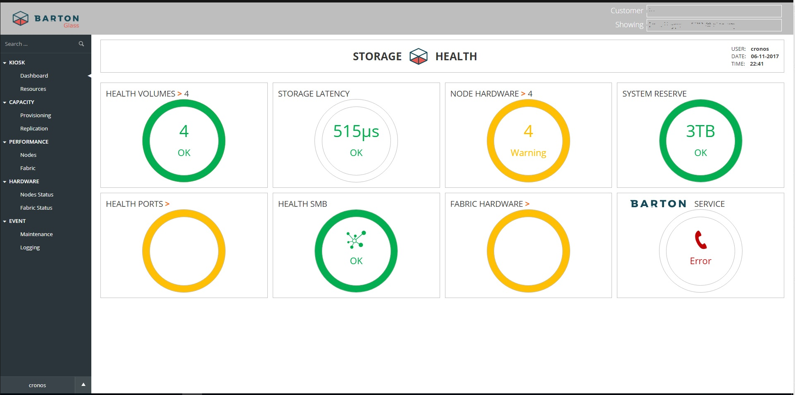
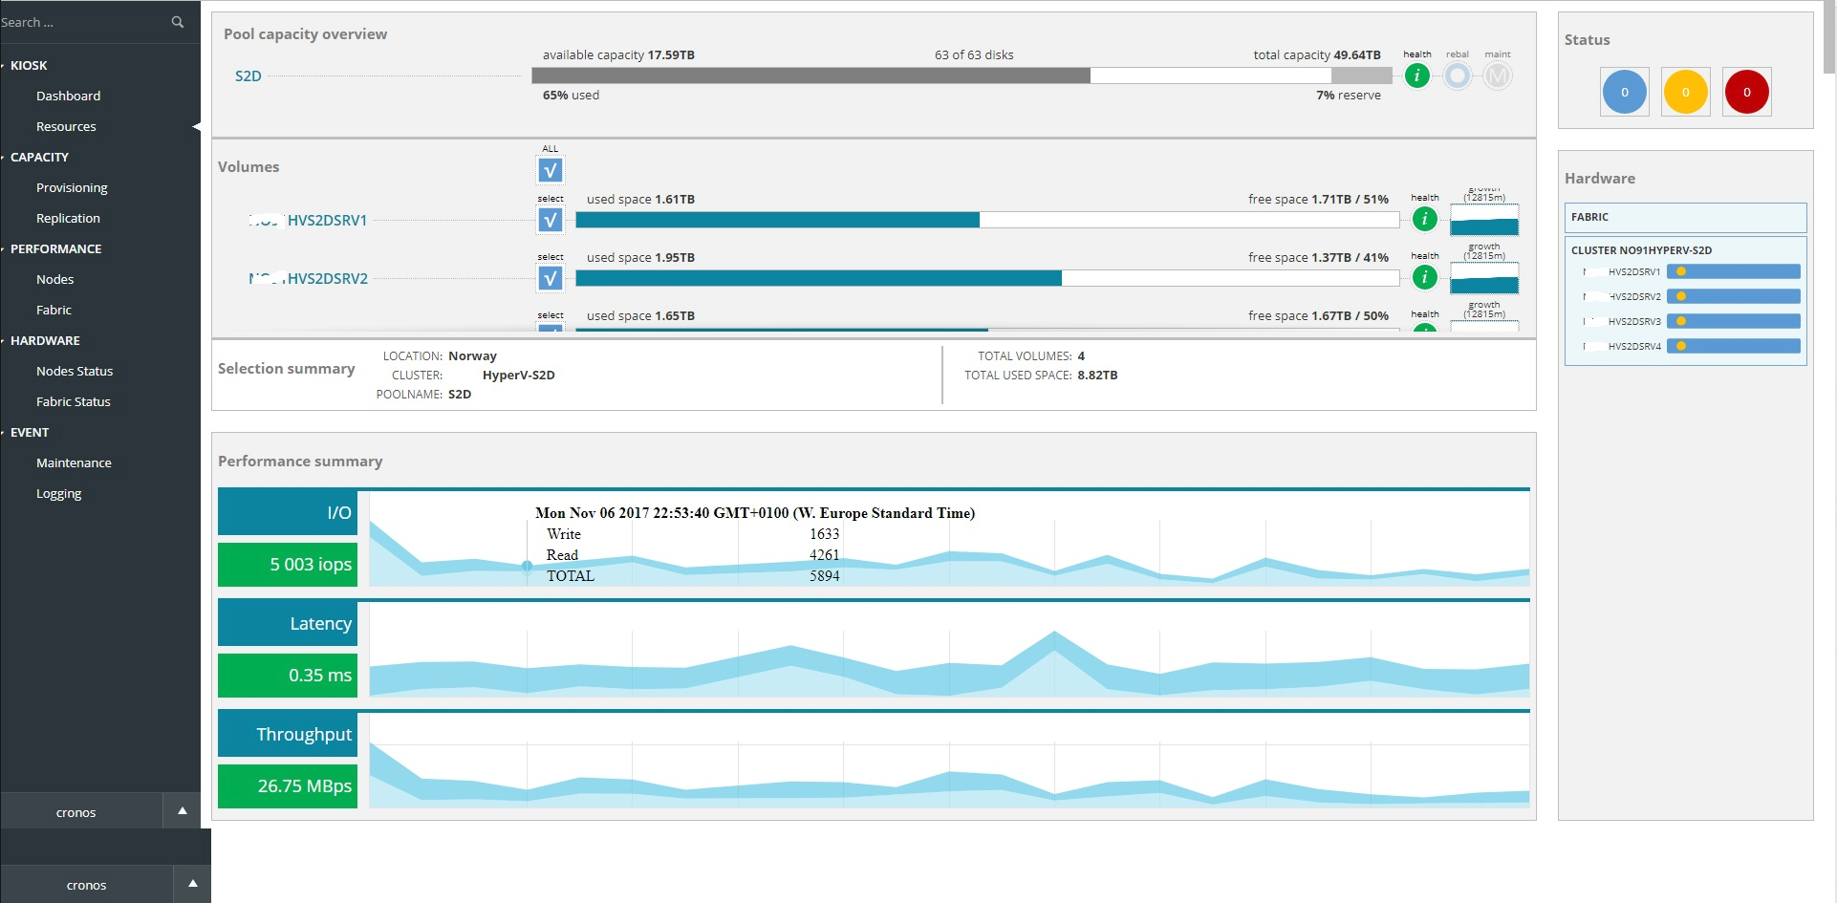
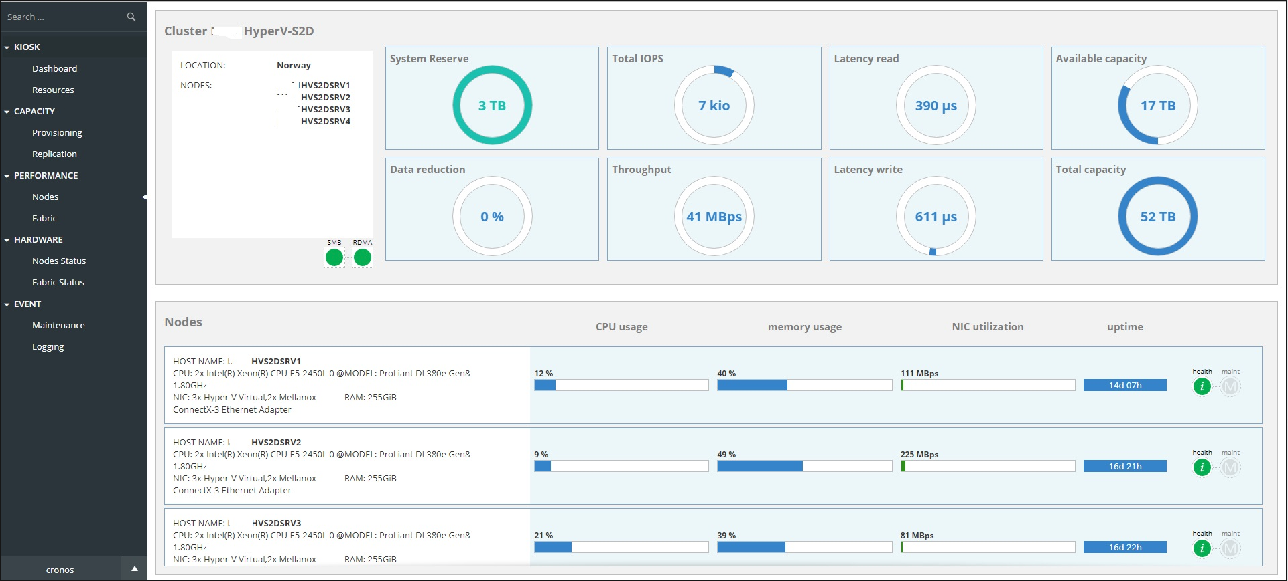
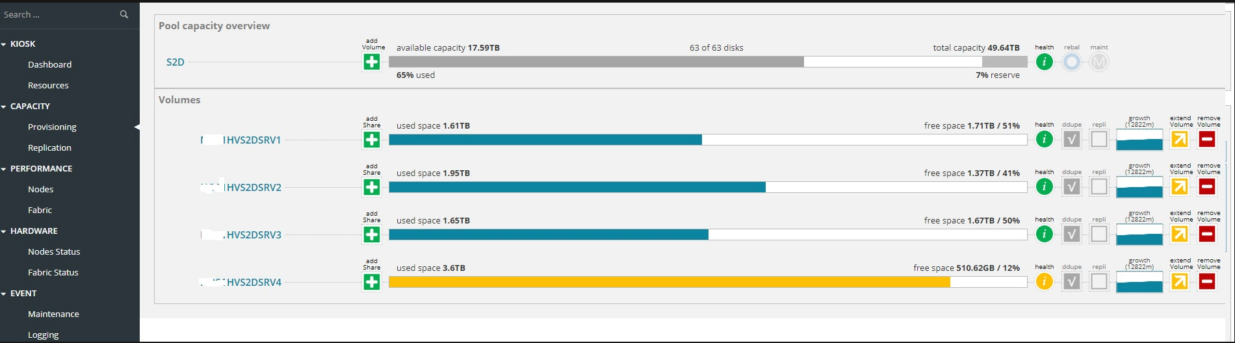
Barton Glass

Slide 55
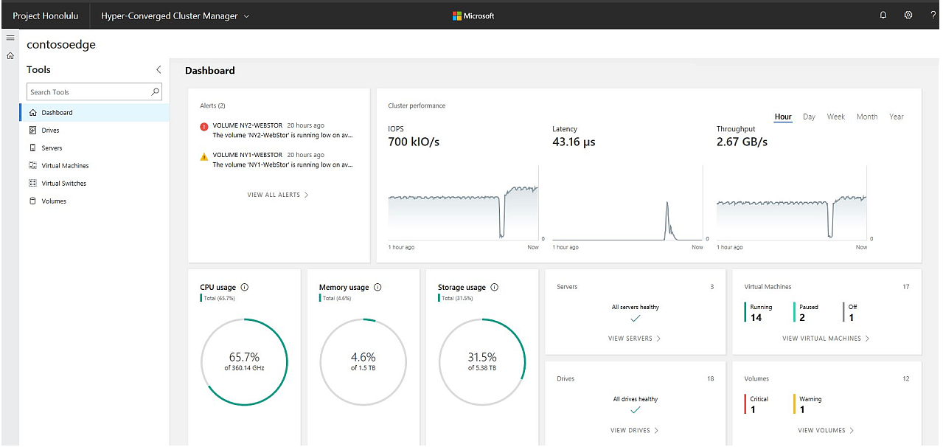
Project Honolulu (Insider Preview)

Slide 56
Troubleshooting S2D

Slide 57
Some nice to have commands
Demo

Slide 58
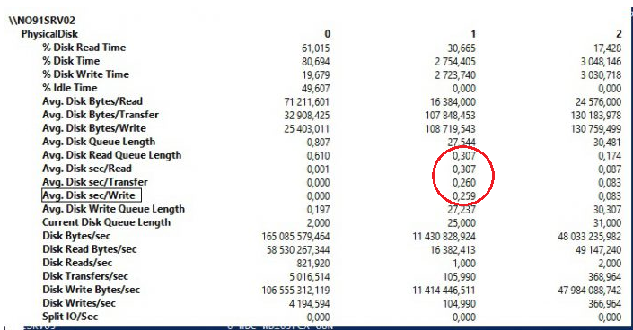
Performance Monitor is one nice to have troubleshooting tool
Why?

Slide 59
My DIY S2D Home Lab

Slide 60
Built On
HP DL380 G6 16bay 2 Intel Xeon 5530
128GB memory
HP H220 HBA and P410i for OS raid
1 Intel P3600 and 1 Intel 750 400GB NVME
2 Samsung SM863 960GB + 4 Smaller Intel SSD’s
2 WD Red 1 TB NAS drives
Mellanox ConnectX3 10Gbit
Dell Force10 S4048-On

Slide 61
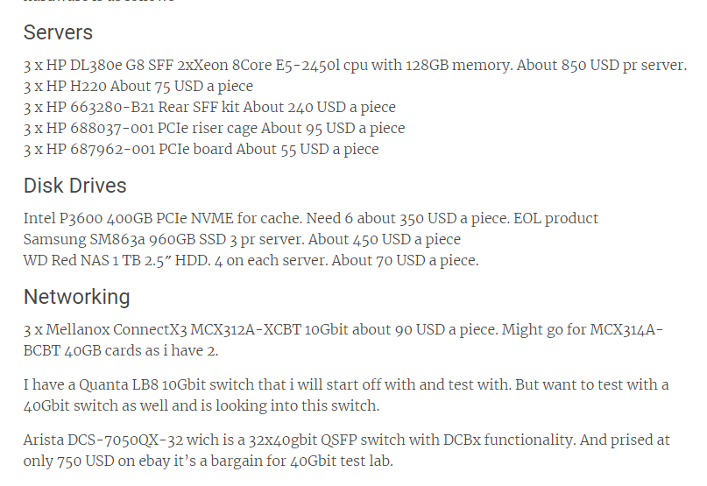
Cost??
Pretty cheap
Less then 4000 Eur0
Expensive part is the disks and the Switch

Slide 62
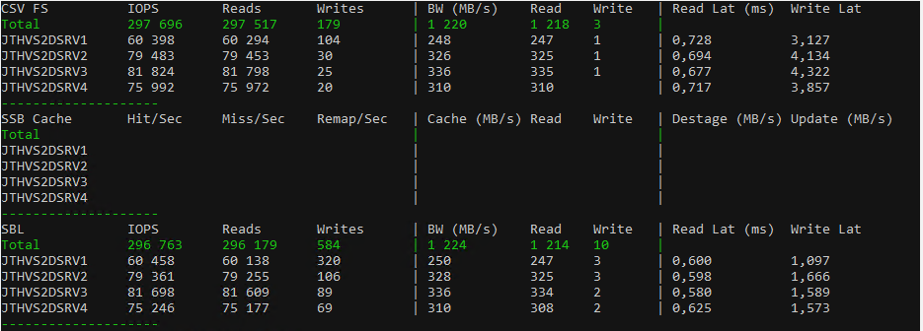
Performance on my Home Lab?

Slide 63
What’s new in S2D in build 1803

Slide 64
Windows Server 2016 1803 for S2D
S2D Enabled
Removed requirement for SCSI Enclosure Service(SAS)
Dedupe for ReFS
Persistent(Storage Class) Memory
Direct Connect SATA devices(Low cost HW)
CSV cache enabled by default

Slide 65
Some nice links for S2D
S2D Home Page https://tinyurl.com/yam35m8p
Drive Symmetry considerations for S2D https://tinyurl.com/y7yx267w
S2D size Calculator https://tinyurl.com/ycznb4vk

Slide 66
Thank you!!
Jan-Tore Pedersen
Senior Consultant @Skill AS
Twitter: @jantorep
Blog: jtpedersen.com
Slack: storagespacesdirect.slack.com

Slide 67
Resources
Slides and demos from the conference will be available at github.com/nordicinfrastructureconference/2018 (bit.ly/2y7JhA3)
For more Windows Server 2016 news for 1803
Join Mikael Nyström tomorrow at 15:15 in room 6

